Slide 1
FINANCIAL SENTIMENTAL ANALYSIS
Vinaykumar Patil
Shruti Bagal
Siddhi Ghorpade
Sachin Ghodake
Rushikesh Nehul
Shrutika Dhabale

Slide 2
OBJECTIVE
The project aims to analyze financial statements & determine if the information is positive, negative or neutral for businesses & the government. We will use R/Python to process the text & extract the relevant information. Emotion mining will also be used to extract emotions from the text data. We will present the analysis using charts like histograms, density plots, barplots & pie-plots. The end product will be made available to users through R Shiny or Flask/Streamlit.

Slide 3
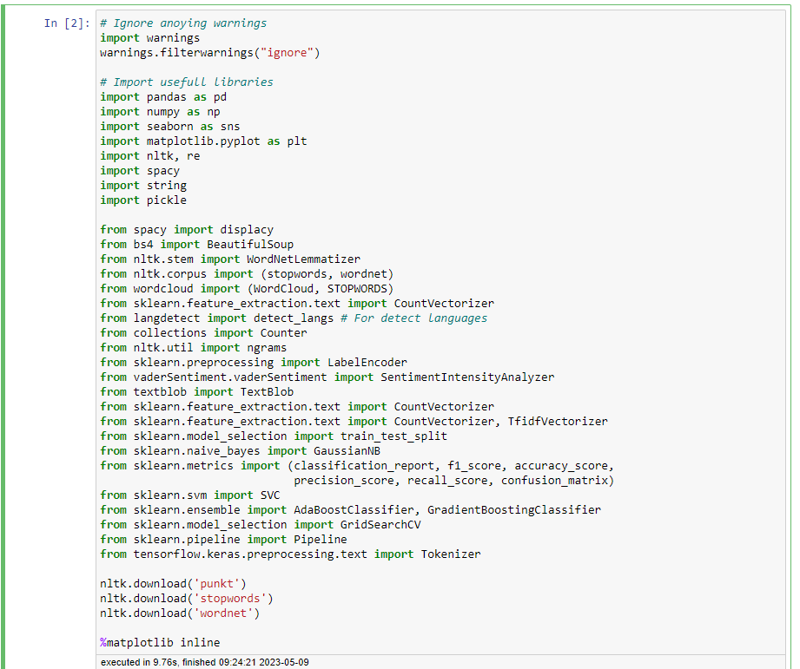
Import Libraries

Slide 4
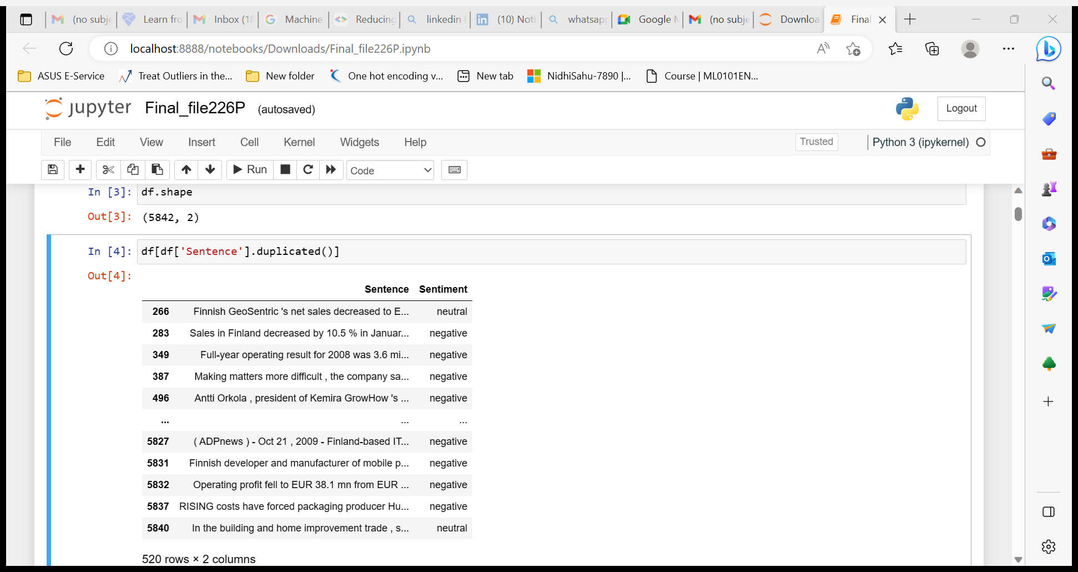
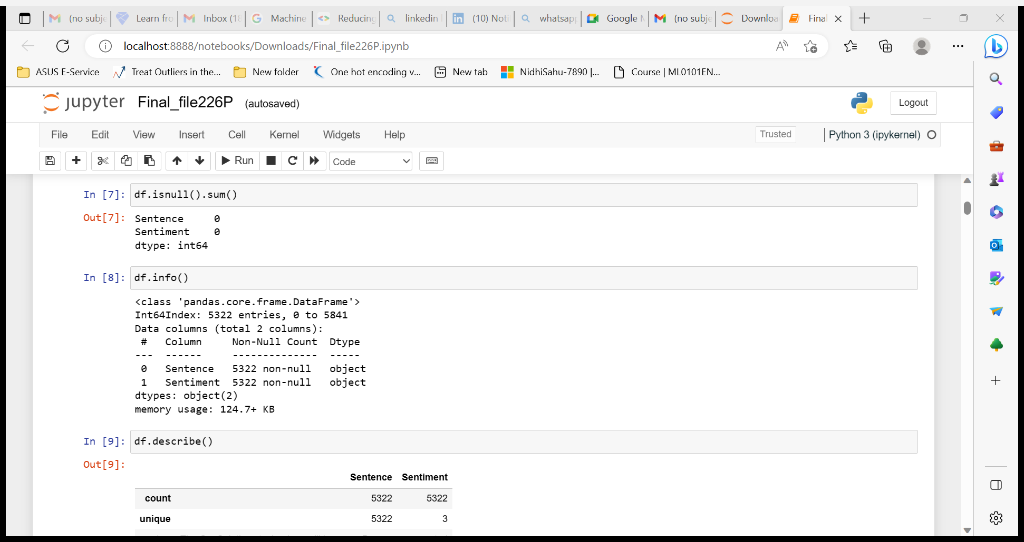
EDA

Slide 5
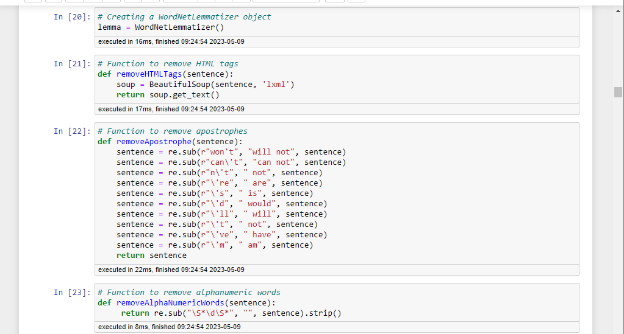
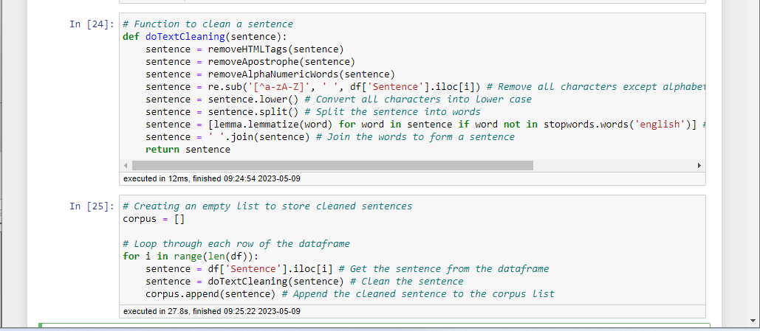
Data Cleaning

Slide 6
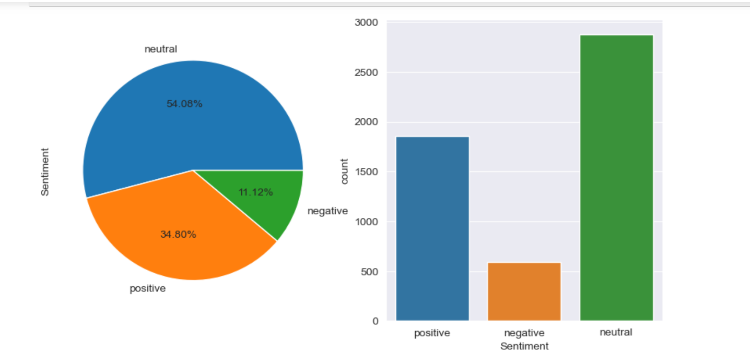
Visualization
Through this visualization we came to know the percentage of a particular Sentiments in given dataset i.e. 54.06% neutral , 34.80% positive and 11.12% negative

Slide 7
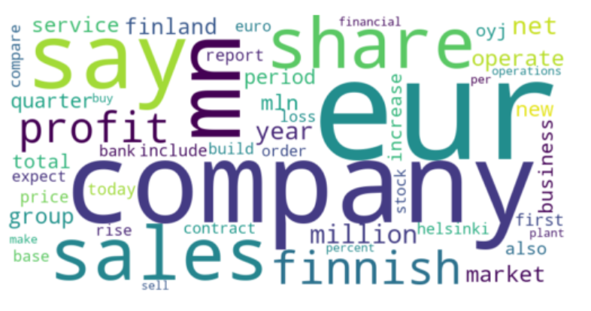
Positive Sentiments Wordcloud
The Positive Sentiments Wordcloud of top 200 words

Slide 8
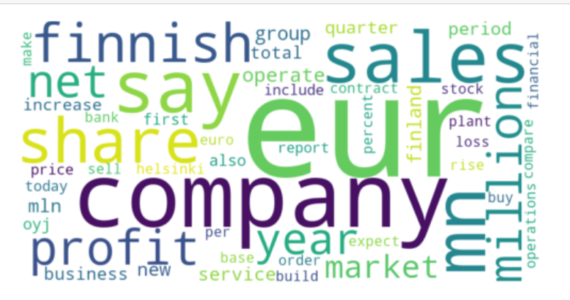
Neutral Sentiment Wordcloud
The Neutral Sentiments Wordcloud of top 200 words

Slide 9
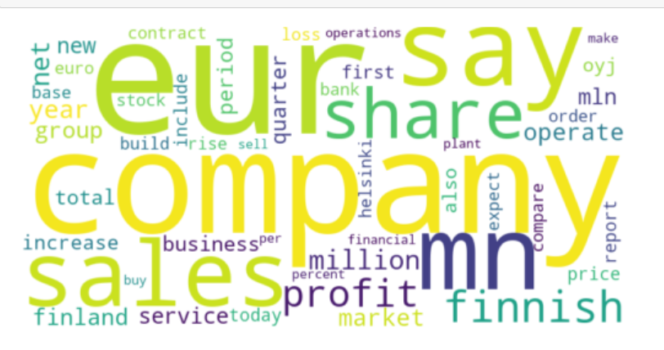
Negative Sentiments Wordcloud
The Negative Sentiments Wordcloud of top 200 words

Slide 10
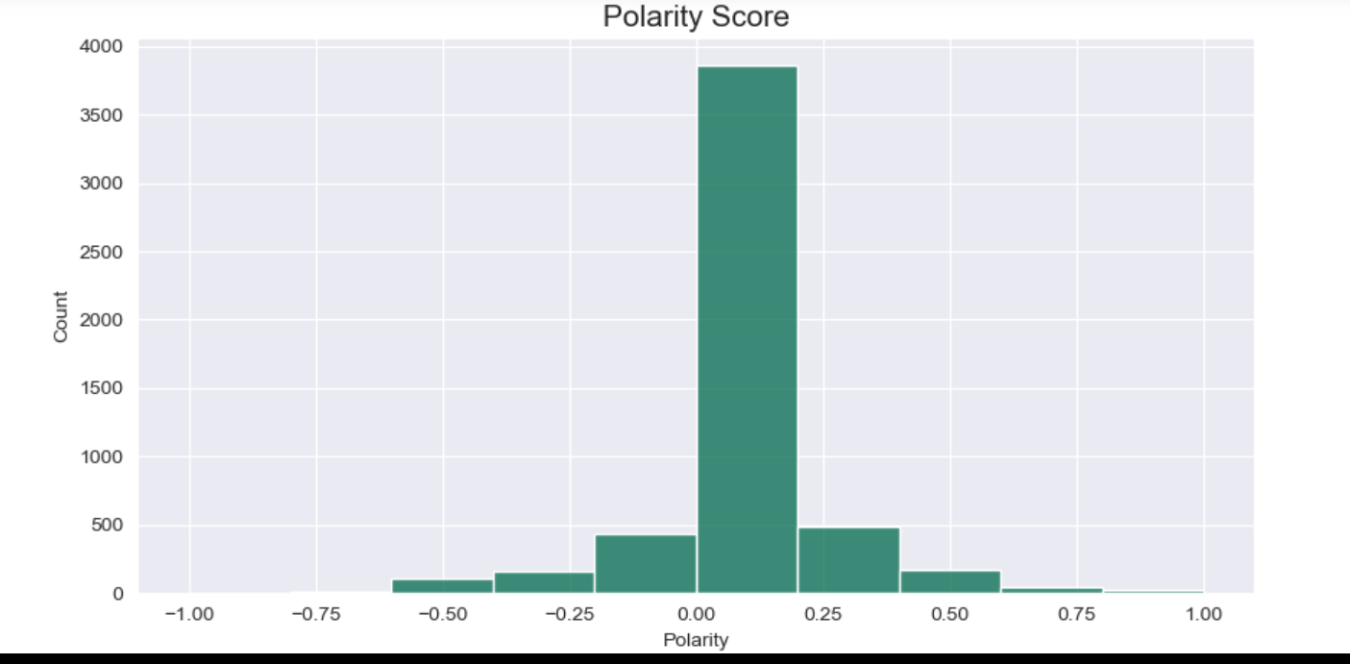
Polarity Score
Here , polarity score is calculated i.e the score below zero is considered as negative , the score above zero is positive and the zero score is neutral

Slide 11
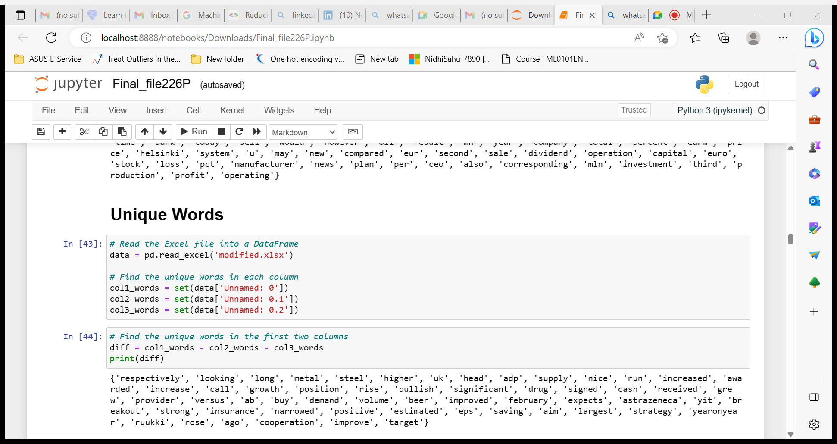
Unique Words

Slide 12
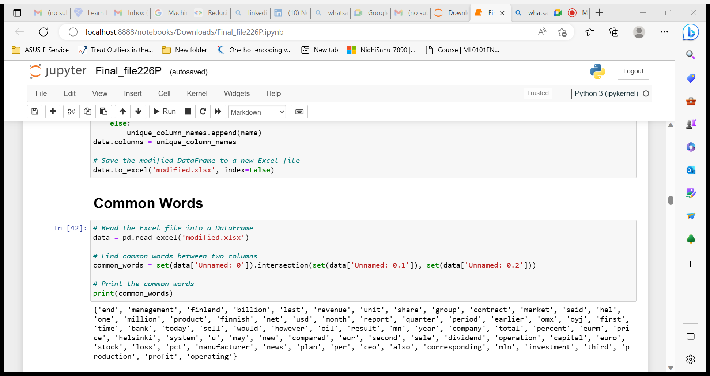
Common Words

Slide 13
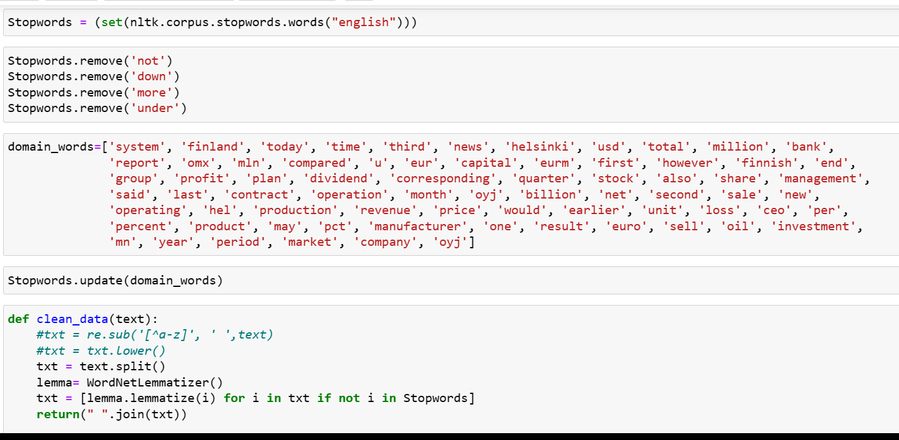
Dropping Common Words

Slide 14
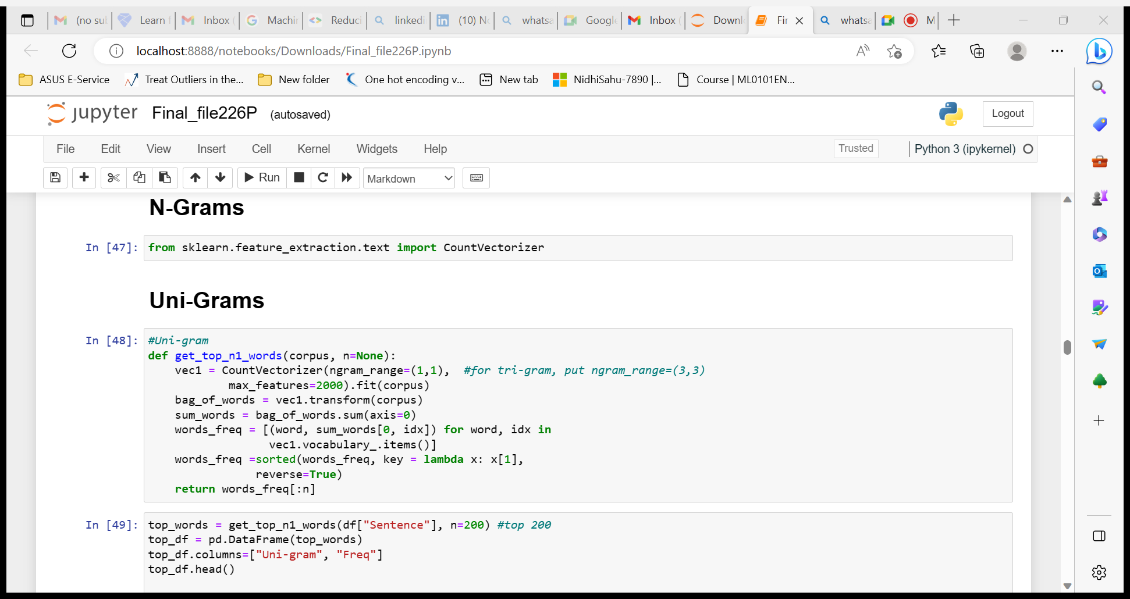
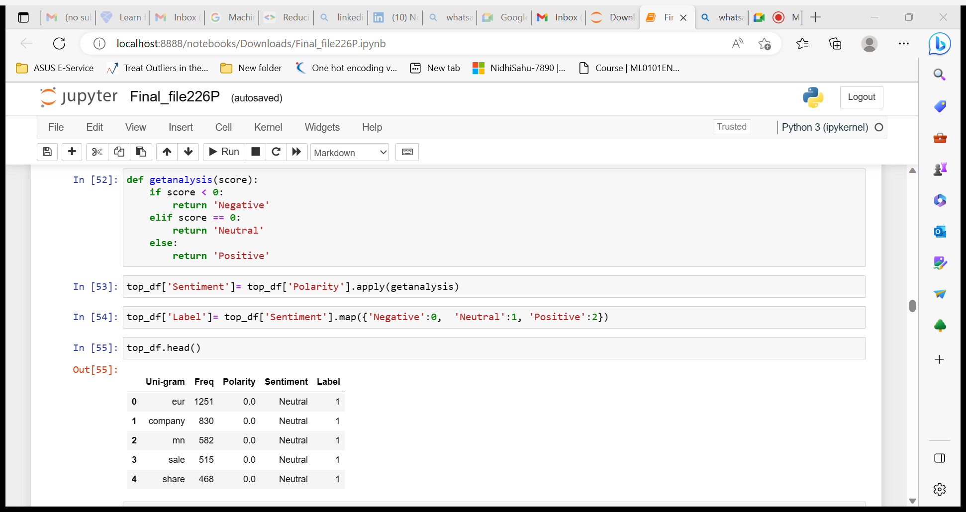
N-Grams

Slide 15
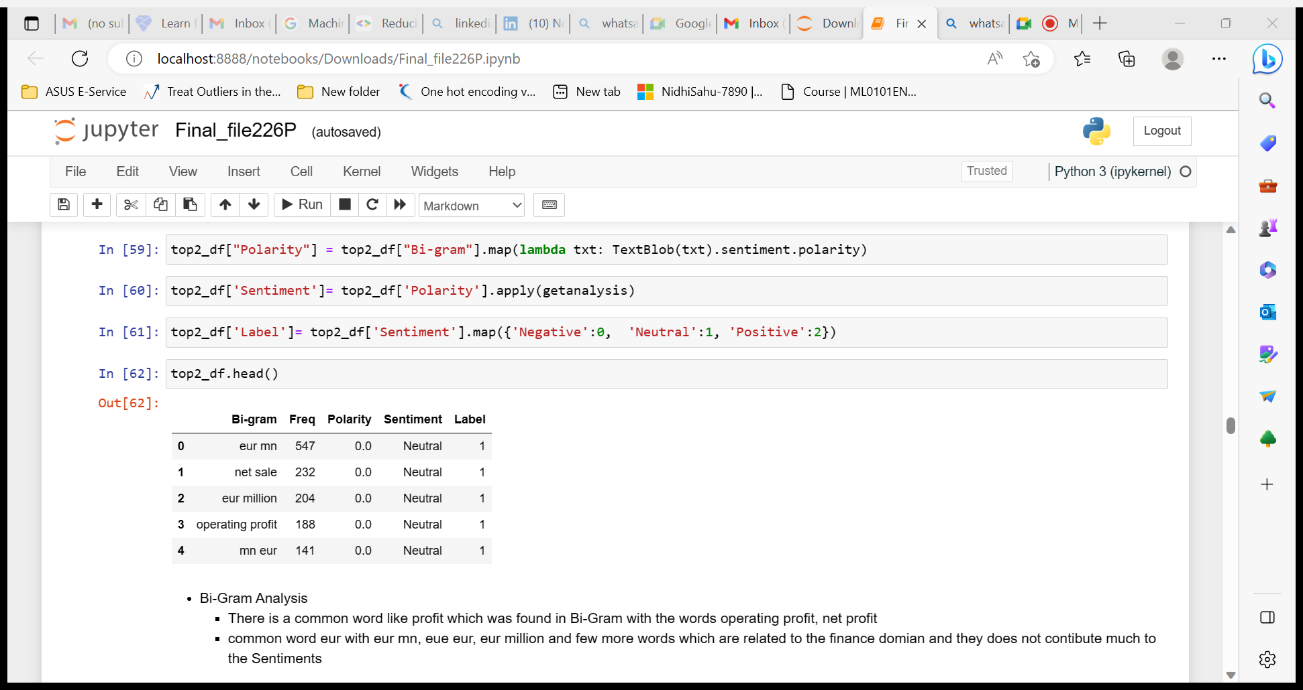
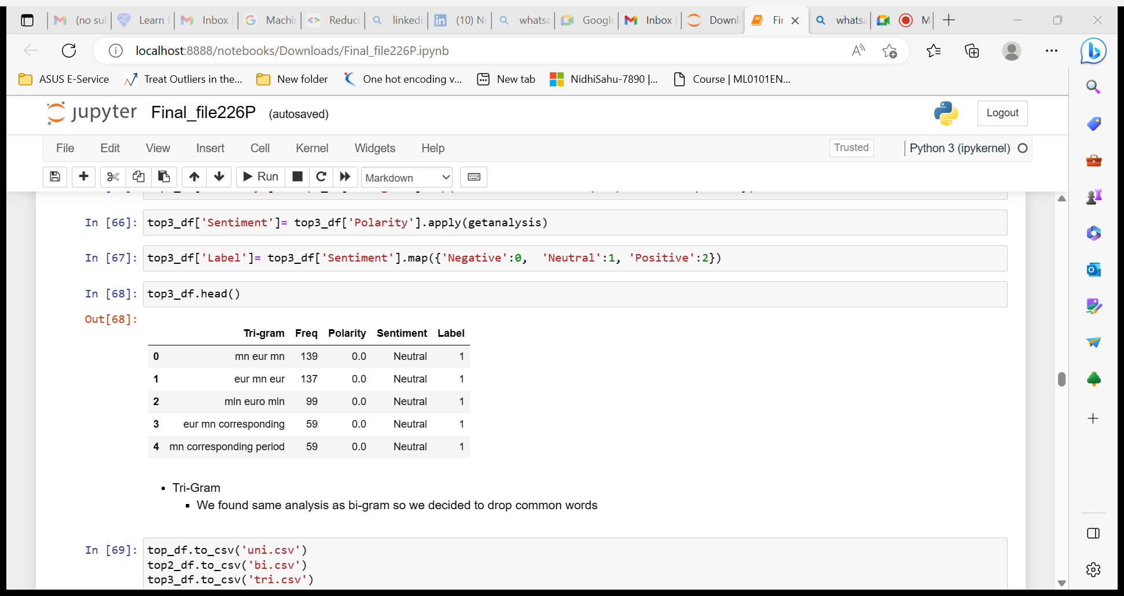
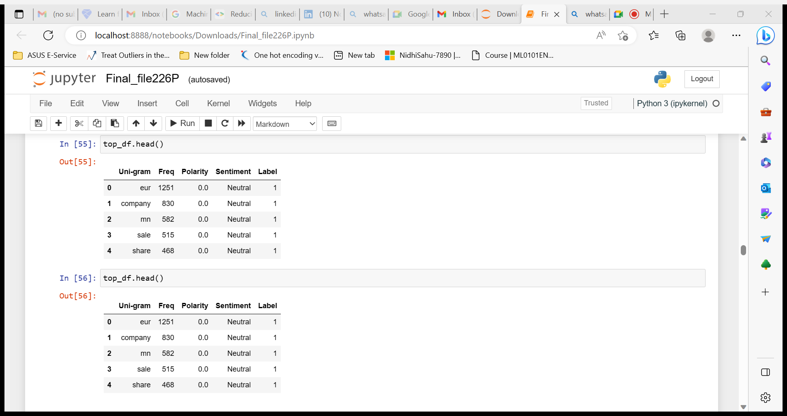
Uni-gram
Bi-gram
Tri-gram

Slide 16
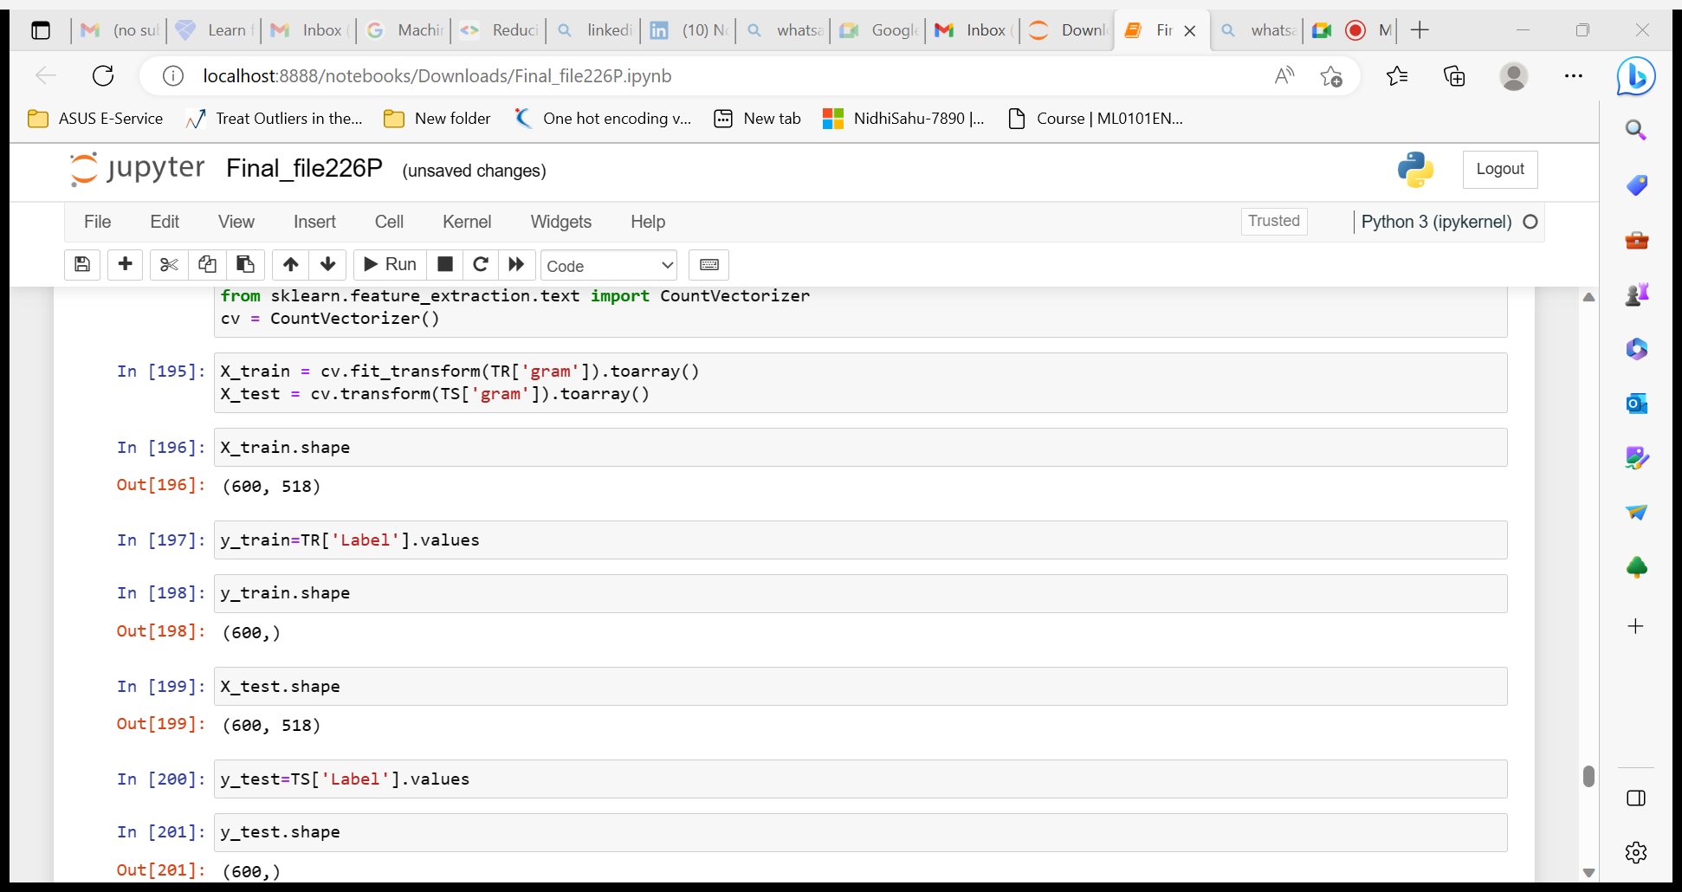
Model Building

Slide 17
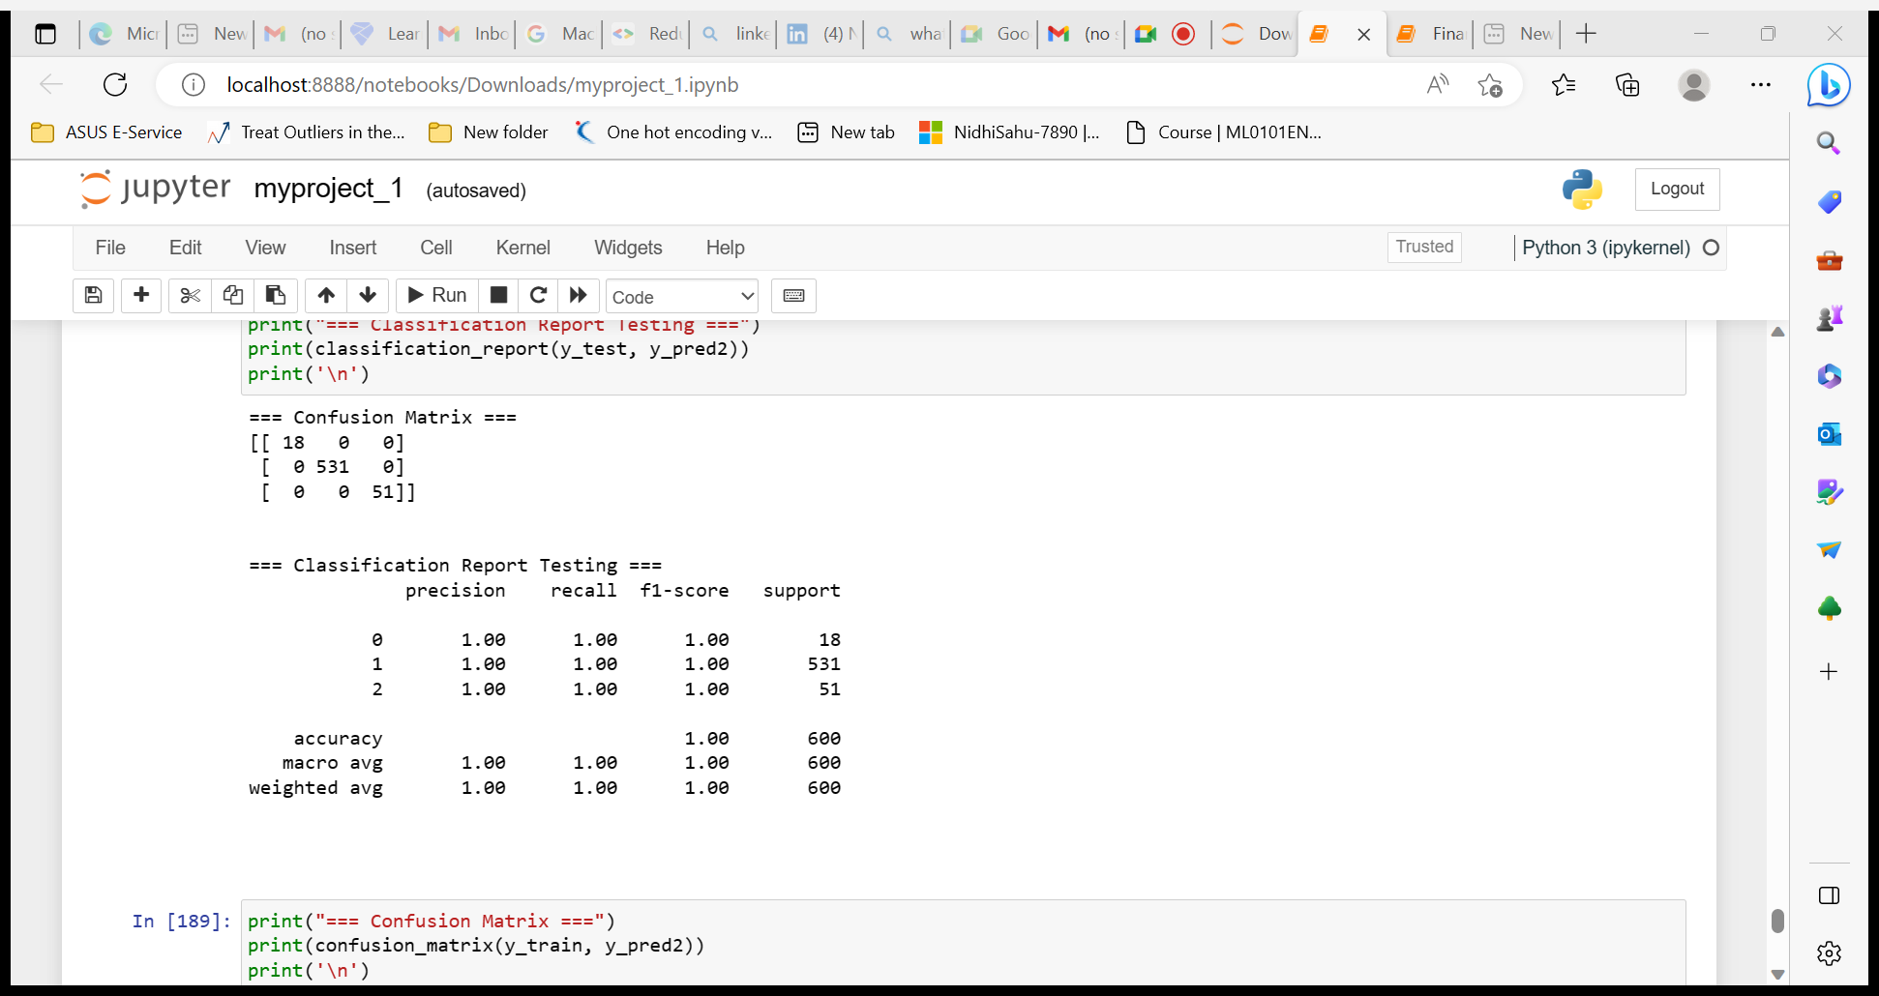
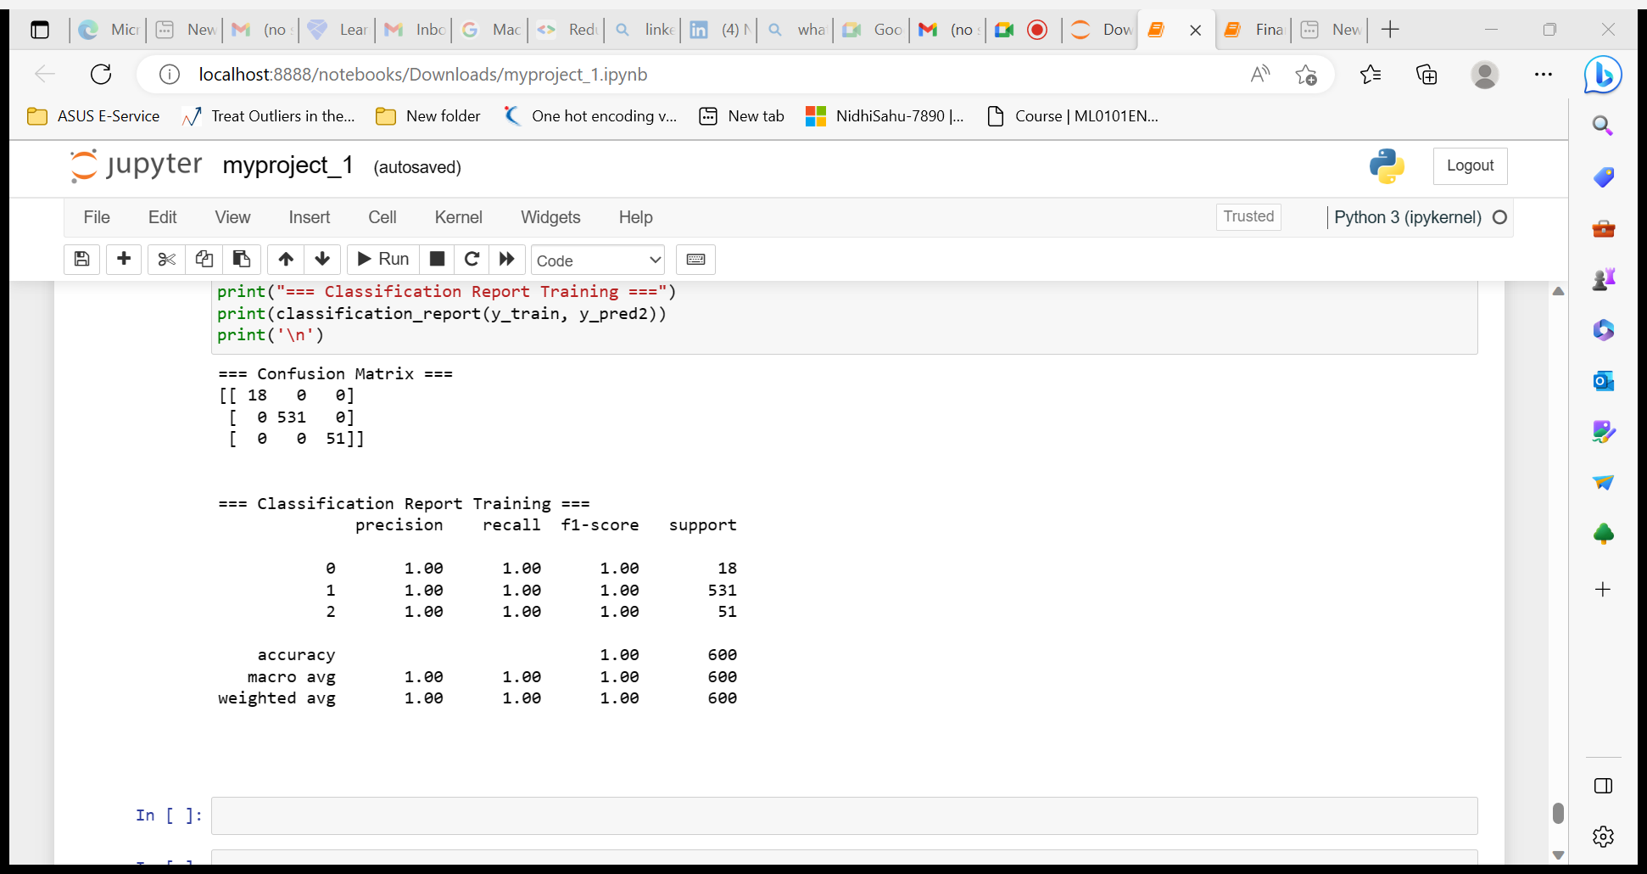
Final Model – Gradient boost
The Final Model is Gradient boost

Slide 18
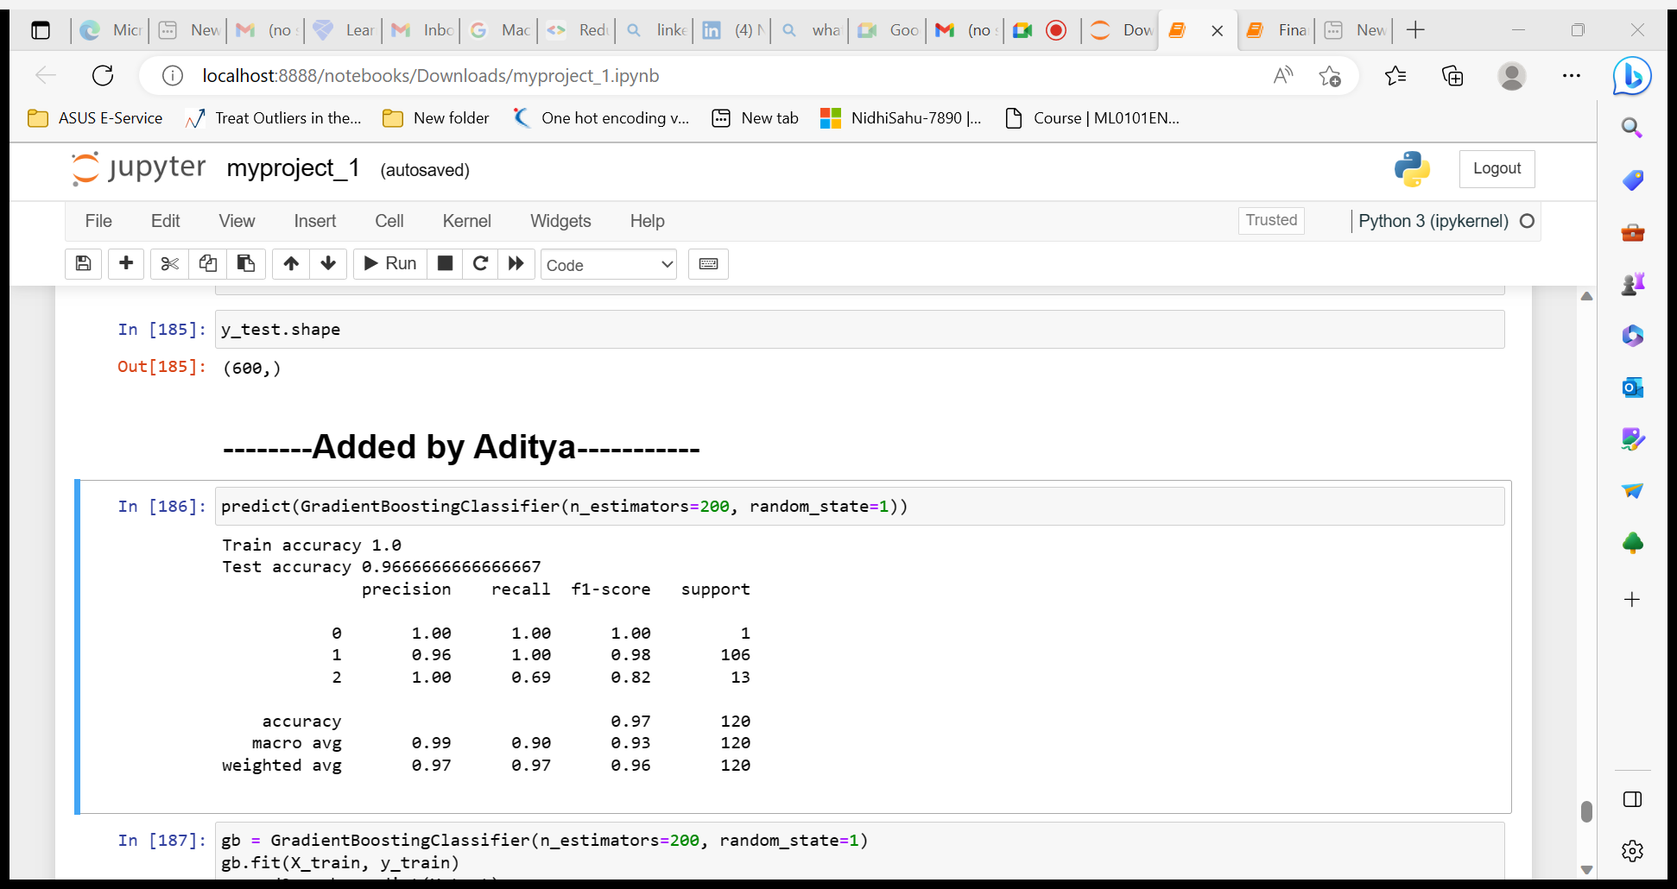
Overall Model Accuracy

Slide 19
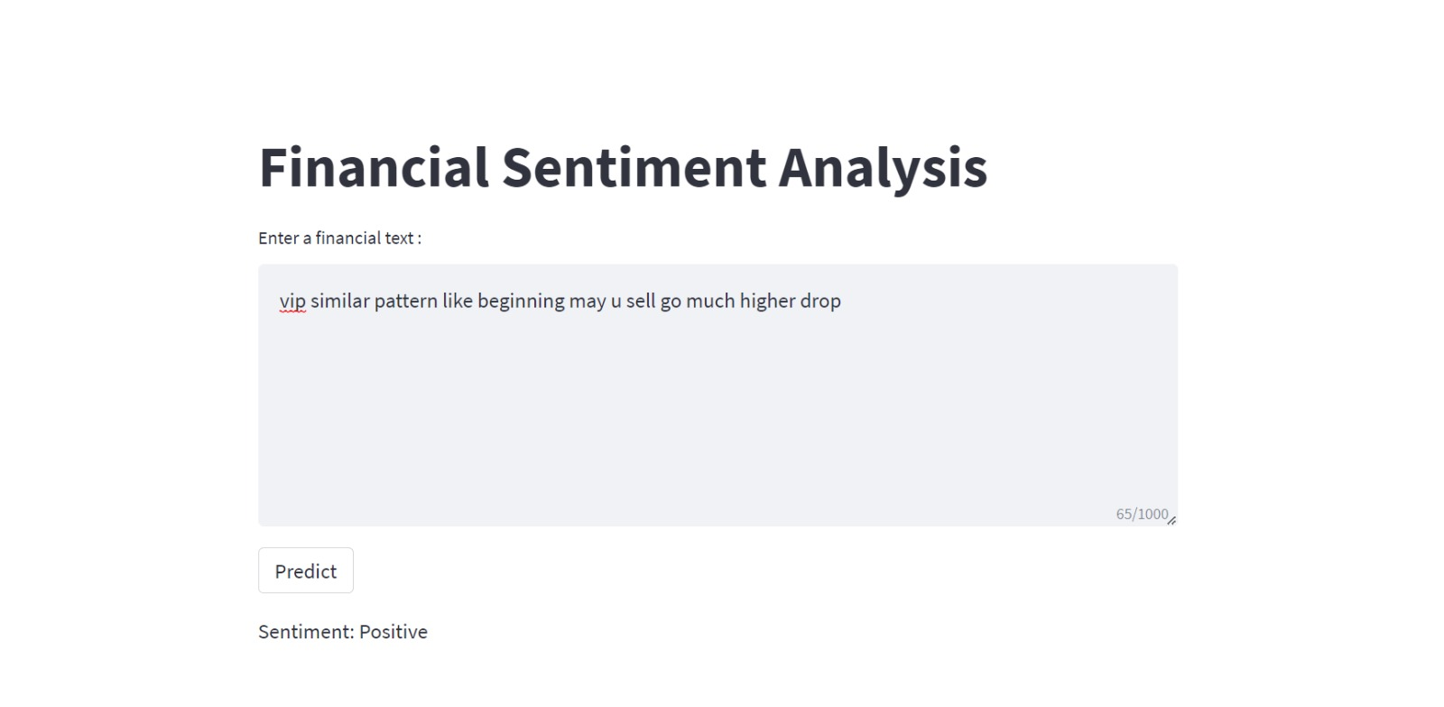

Slide 20
Thank you

